Slide 1
Machine Learning
Part III

Slide 2
Case Study: Multiple Linear Regression with the California Housing Dataset
California Housing dataset bundled with scikit-learn
The dataset has 20,640 samples, each with 8 numerical features
We can do a multiple linear regression using all eight features (as opposed to the Single Linear Regression using one feature in the previous case)
Make more sophisticated housing price predictions

Slide 3
The Dataset
derived from the 1990 U.S. census, using one row per census block group
A block group is the smallest geographical unit for which the U.S. Census Bureau publishes sample data (typically has a population of 600 to 3,000 people)."

Slide 4
The Dataset
The dataset has 20,640 samples—one per block group—with 8 features each:
median income—in tens of thousands, so 8.37 would represent $83,700
median house age—in the dataset, the maximum value for this feature is 52
average number of rooms
average number of bedrooms
block population
average house occupancy
house block latitude
house block longitude

Slide 5
The Dataset
Target — median house value in hundreds of thousands, so 3.55 would represent $355,000
Maximum for this feature is 5 for $500,000
Reasonable to expect more bedrooms, more rooms or higher income would mean higher house value
Combine all numeric features to make predictions
More likely to get more accurate predictions than with simple linear regression

Slide 6
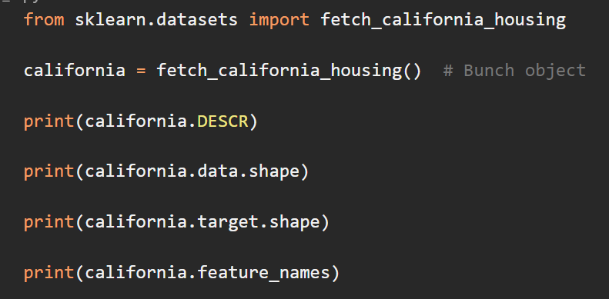
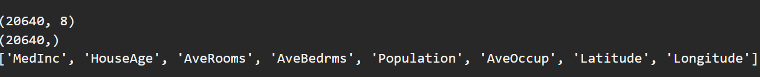
Loading the Dataset
Use sklearn.datasets function fetch_california_housing

Slide 7
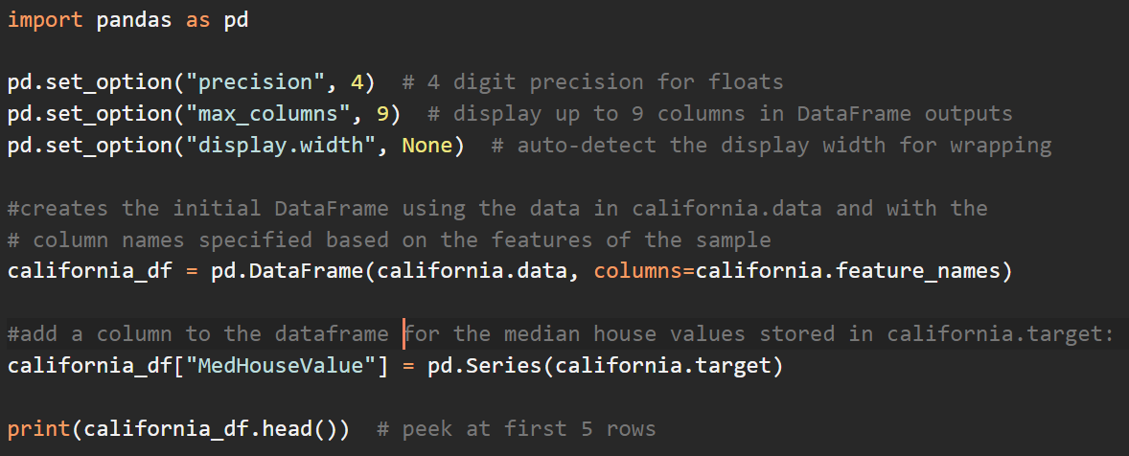
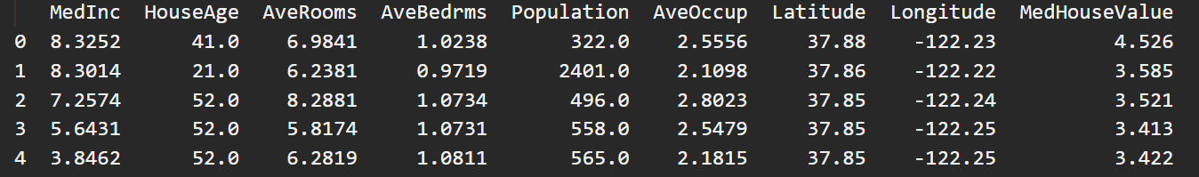
Exploring the data with Pandas

Slide 8
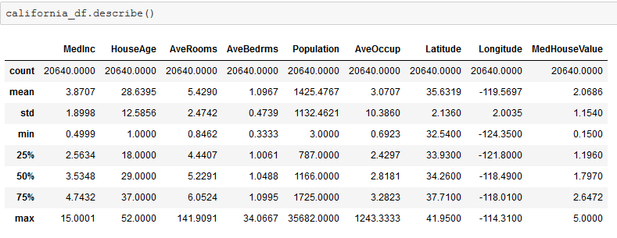
Exploring the data with Pandas
using the describe method of dataframes we can get some statistical information

Slide 9
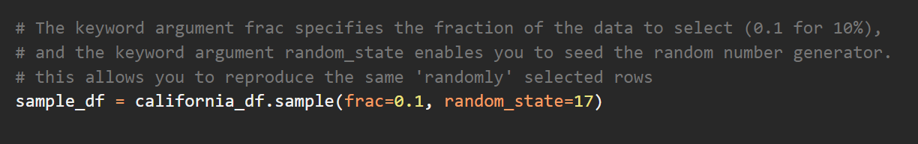
Visualizing the Features
Plot the target value against each feature
How does each feature relate to the median home value (target)
Use Dataframe sample method to randomly select 10% of the 20,640 samples to graph it

Slide 10
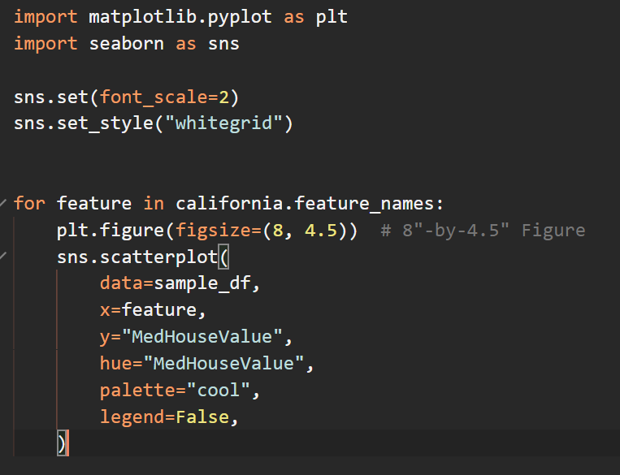
Visualizing the Features

Slide 11
Visualizing the Features
In each graph, there is a horizontal line of dots at the y-axis value 5, which represents the median house value $500,000.
The graphs showing the latitude and longitude each have two areas of especially significant density. They are the Los Angeles and San Francisco areas.
In the HouseAge graph, there is a vertical line of dots at the x-axis value 52. The cap for the age of the home was 52 years.

Slide 12
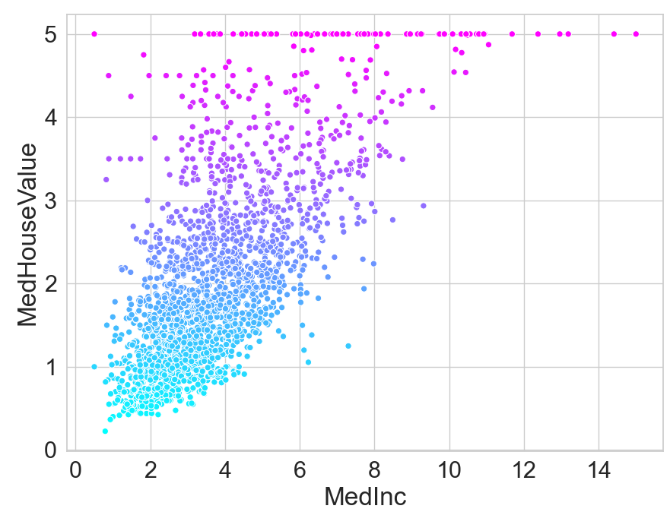
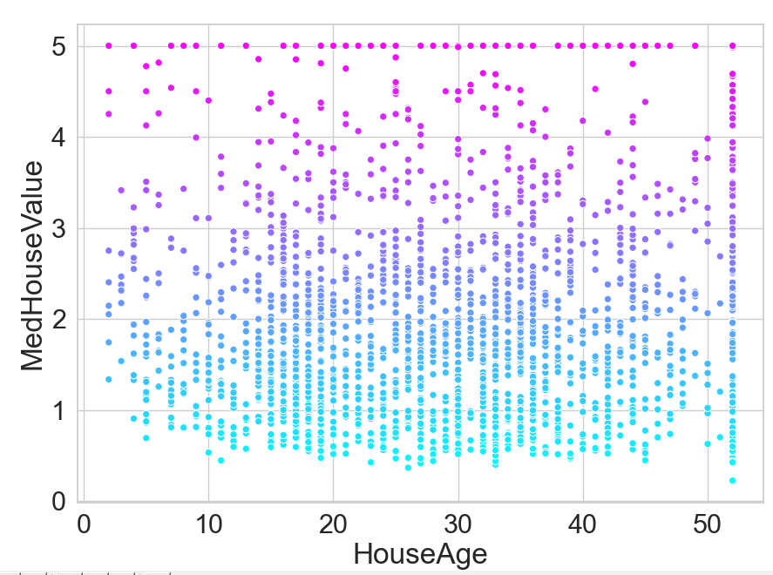
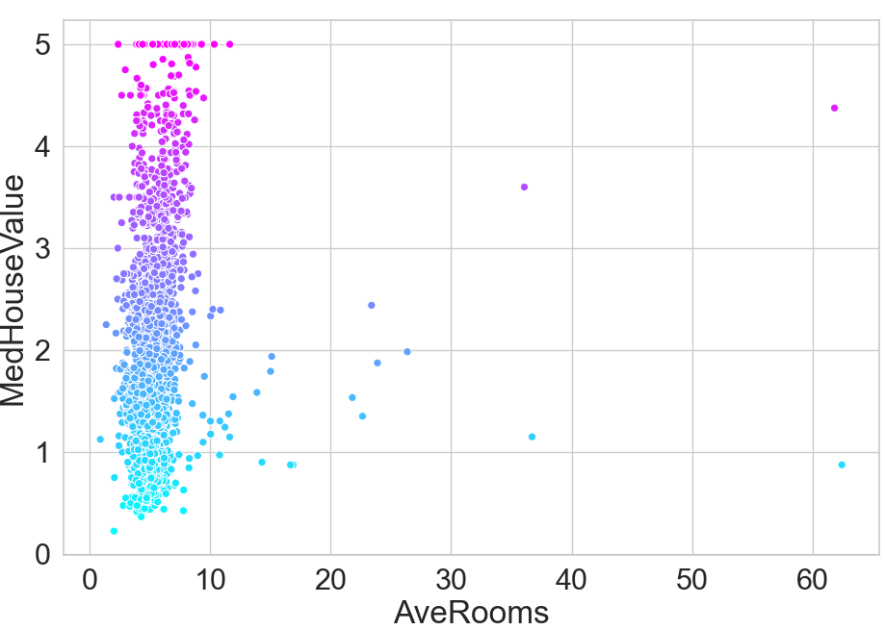
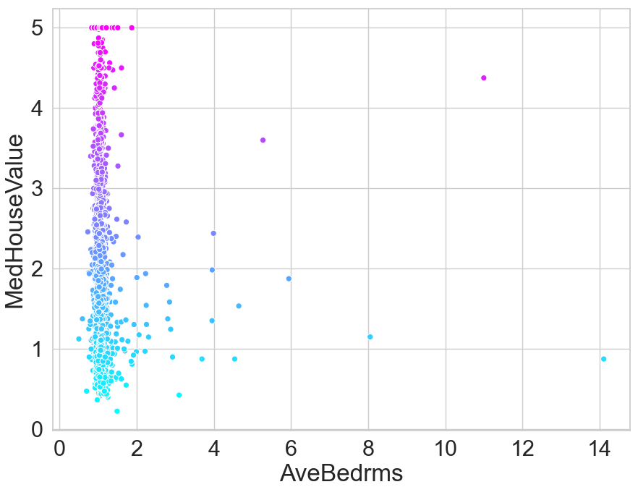
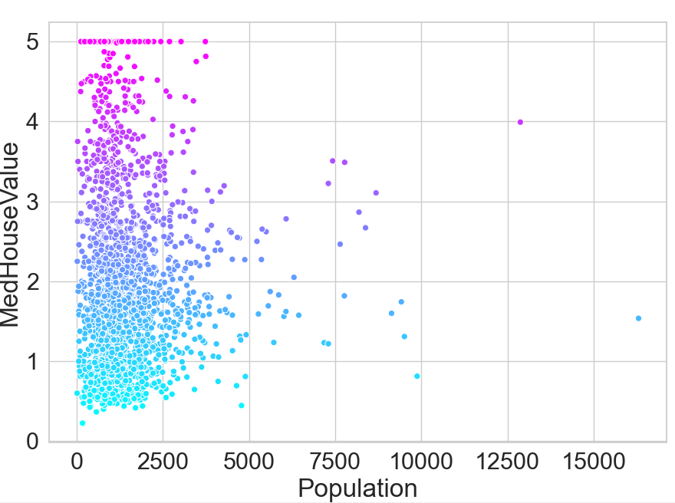
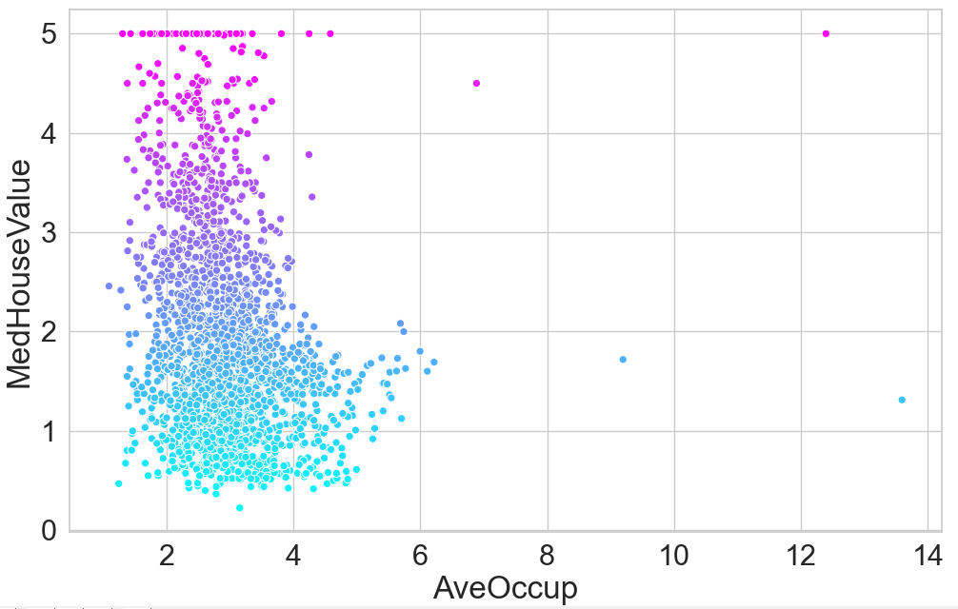
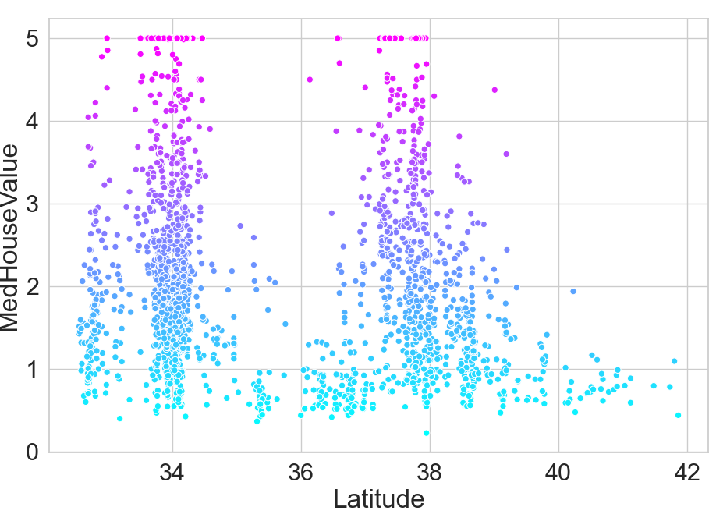
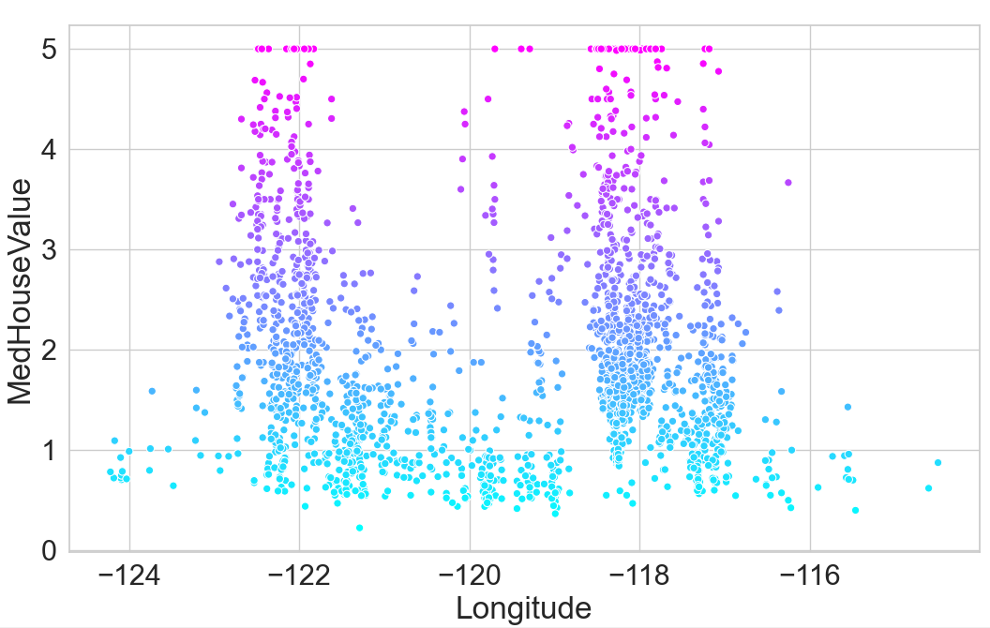

Slide 13
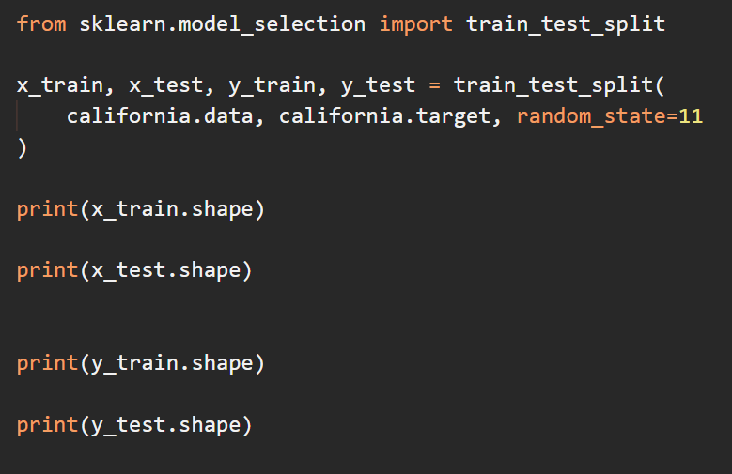
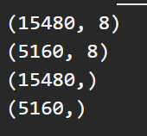
Splitting the Data for Training and Testing

Slide 14
Training the Model
a LinearRegression estimator uses all the features in the dataset’s data array to perform a multiple linear regression.
An error occurs if any of the features are categorical rather than numeric.
If a dataset contains categorical data, you either must preprocess the categorical features into numerical ones
A benefit of working with scikit-learn’s bundled datasets is that they’re already in the correct format for machine learning using scikit-learn’s models.

Slide 15

Training the Model
Multiple linear regression produces separate coefficients for each feature (stored in coeff_)
Multiple linear regression produces one intercept (stored in intercept_)
For positive coefficients, the median house value increases as the feature value increases.
For negative coefficients, the median house value decreases as the feature value increases.

Slide 16
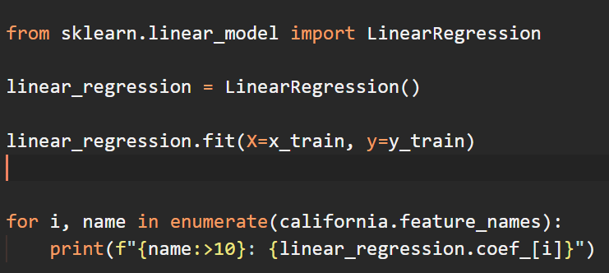
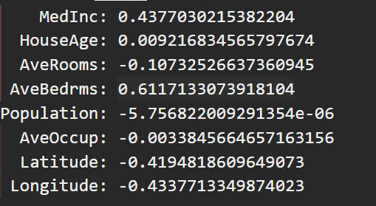
Training the Model

Slide 17
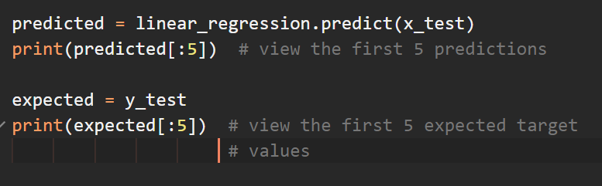
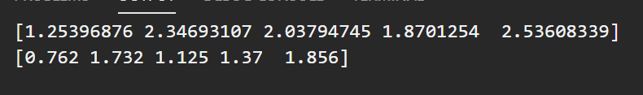
Testing the Model
With classification, we saw that the predictions were distinct classes that matched existing classes in the dataset. With regression, it’s tough to get exact predictions, because you have continuous outputs.

Slide 18
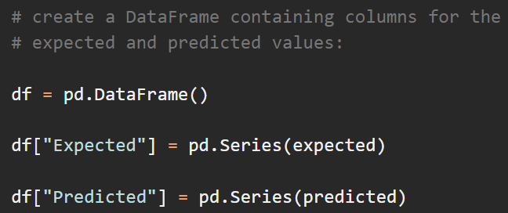
Visualizing the Expected vs. Predicted Prices

Slide 19
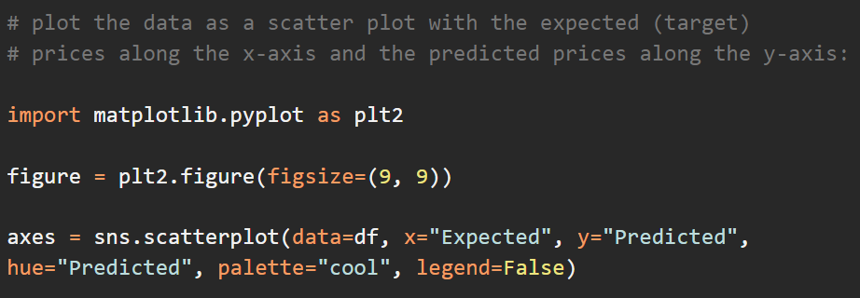
Visualizing the Expected vs. Predicted Prices

Slide 20
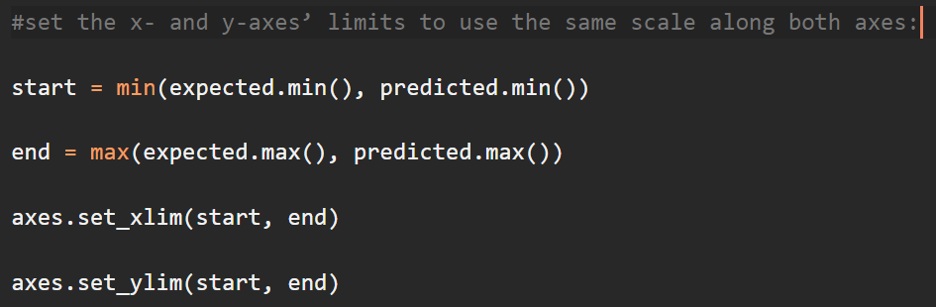
Visualizing the Expected vs. Predicted Prices

Slide 21
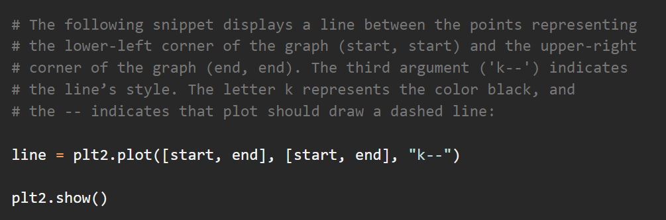
Visualizing the Expected vs. Predicted Prices

Slide 22
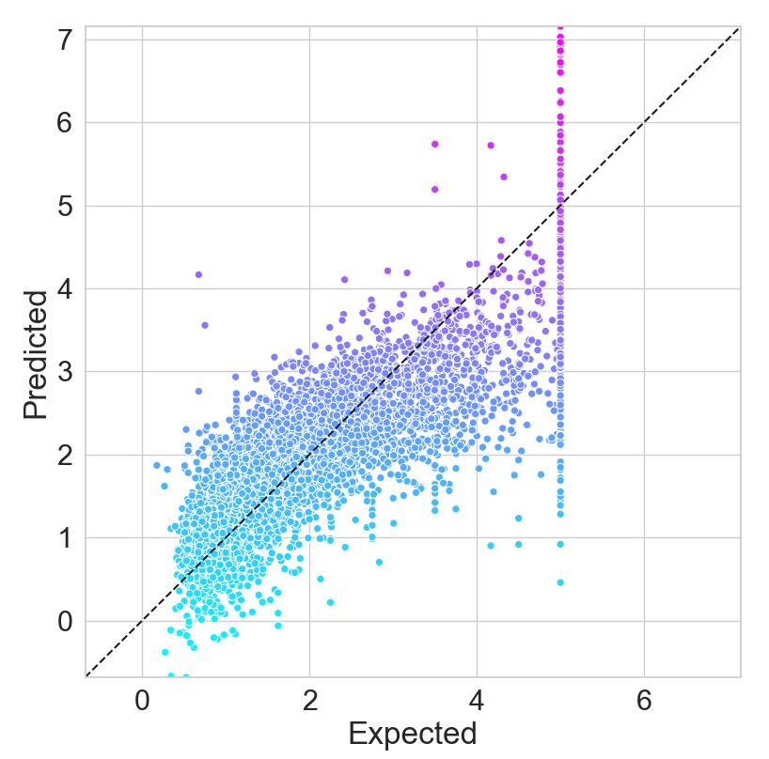
Visualizing the Expected vs. Predicted Prices
If every predicted value were to match the expected value, then all the dots would be plotted along the dashed line.
It appears that as the expected median house value increases, more of the predicted values fall below the line.
So the model seems to predict lower median house values as the expected median house value increases.

